Slide 1
Facial Emotion Recognition
using CNN

Slide 2
JAMIAMILLIAISLAMIA
PRESENTED BY:-
SHAFATHUSSAIN
NADI HABIB MOHD.MUZAMMIL
DEPARTMENT OF COMPUTER SCIENCE & ENGINEERING

Slide 3
Content
INTRODUCTION
EXISTING WORKS
DATASETS
ALGORITHM
ADVANTAGES

Slide 4
INTRODUCTION
Facial Emotion is vital part of communication . However it is not delimited by facial expression because it is whole set of physical , chemical and electrical changes that going around .
There are seven emotion globally accepted which are anger,fear,happiness, disgust,sadness, contempt .
Studies say that two third of communication is non verbal.
It is vital part of human computer interaction and robotics programm that is going around the world.

Slide 5
EXISTING WORK
Paper 'Face Expression recognition with 2 channel convolutional neural network' by Hamester(2015).2- channel CNN was used to achieve an acc-uracy of 94.1% using JAFFE dataset.[1]
Xiu and Hu proposed a Feature Redundancy Reduced(FRR) CNN for facial expression recognition(2017). FRR-CNN presents a discriminative mutual difference among feature maps of the same layer.Helps in creating less redundant features and more compact representation of images[2]

Slide 6
DATA SOURCE
The data consists of 48x48 pixel grayscale images of faces. The faces have been automatically registered so that the face is more or less centered and occupies about the same amount of space in each image. The task is to categorize each face based on the emotion shown in the facial expression in to one of seven categories (0=Angry, 1=Disgust, 2=Fear, 3=Happy, 4=Sad, 5=Surprise, 6=Neutral).
The set consists of 28,709 examples. In our project , this set is divided into different ratio to study the effect of changes .

Slide 7
Algorithm
Data Preprocessing
Creating Neural Network Architecture
Training The Architecture
Testing in Validation Set
Testing on Test Set
Real Time Testing

Slide 8
Algorithm: Data Preprocessing
Basically FER - 2013 Dataset , we obtain it from Kaggle is 48*48 pixel images of different posture of faces and having label one of the seven facial expressions . It is simple .csv file but the pixel values are in sting format . So it is brought in integer value and then converting into numpy array .
Also some sort of minmax normalization to reduce pixel value to range of 0-1 .
In the real time application for each image sequence we first use Cascaded Classifier to grab the facial portion followed by compressing it to 48 * 48 pixel using image pyramid or KNN or expanding if image is smaller than 48*48 .

Slide 9
Algorithm: Create CNN Architecture
CNN comprises of basically 4 layers -
Convolutional Layer
Relu Layer
Max Pooling Layer
Fully Connected Layer

Slide 10
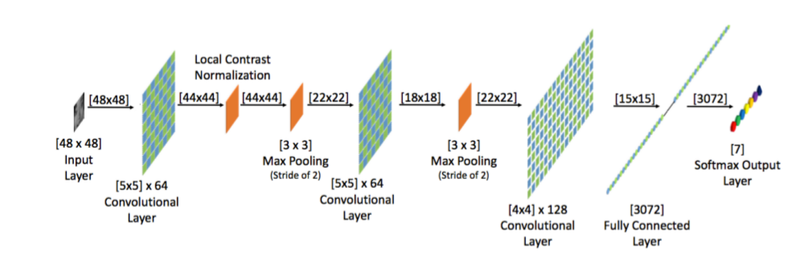
Algorithm: CNN Architecture
In our initial implementation we basically use following kind of architecture.

Slide 11
Algorithm: Training and Testing
Using the above architecture we try to record the accuracy on training and cross validation set . We use then save the trained model for further testing .
After that we tweak the parameter to record the improvement .
Initial testing is only on FER data .
Real time testing is using webcam and video feed
We will integrate above in GUI frame work to develop app like front end.

Slide 12
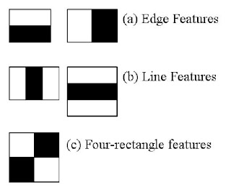
Algorithm: Haar Cascade Classifier
Haar Cascade Classifier is used for the grabbing the facial part from the image .
It is a machine learning based approach where a cascade function is trained from a lot of positive and negative images
The algorithm has four stages:
Haar Feature Selection
Creating Integral Images
Adaboost Training
Cascading Classifiers

Slide 13
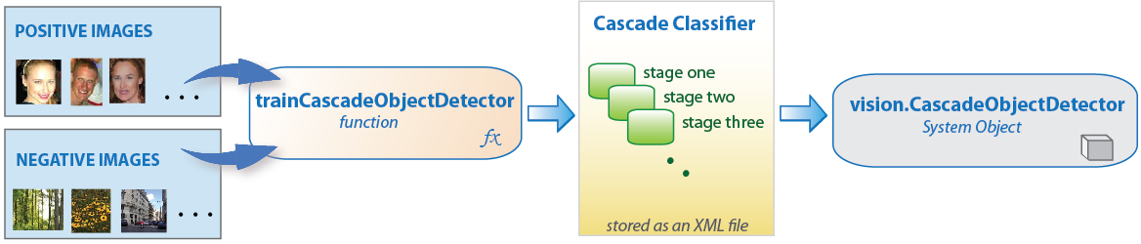
Algorithm: Haar Cascade Classifier

Slide 14
WORK FLOW
Data Preprocessing
Creating Architecture
Training Our Model
-
Saving Our Model
Testing our
model on test set
Image
Grabing Our Face Data
Restoring our Model
Real Time Testing
Video Data
Emotion Status

Slide 15
TOOLS USED:
Python 3: Extremely easy and most prefered language for the Deep Learing because of itssimplicity and ease .
Numpy and Pandas: For manipulating and preprocessing of the data.:
Tensorflow: Python Deep Learning library for the actual implementing in the CNN.
OpenCV: In the real time application it will be used for the grabbing the facial data andtransforming if necessary.
KerasPython: Deep Learning supporting library that facalitates the creation of theCNN layer and saving the trained model and reloding if necessary.

Slide 16
TOOLS USED
PyQt : It is a wrapper over C++ Qt module. it is used for making graphical user interface(GUI).
Matplotlib : for creating interactive graphs and displaying all dataset.
QtDesigner: drag and drop tool for creating layout of our interface.

Slide 17
REFRENCES
Face expression recognition with a 2-channel Convolutional Neural Network by Hemster, Barros, Wermter,University of Hamburg ,Department of Informatics http://www.informatik.uni-hamburg.de
Dictionary learning feature space via sparse representation classification for facial expression recognition by Zhe Shun,Zheng Ping Hu, Meng Wang .

